Slide 1
FIRST-ORDER (PREDICATE) LOGIC
Individual Homework – Bostan Maria

Slide 2
THEORY ASPECTS

Slide 3
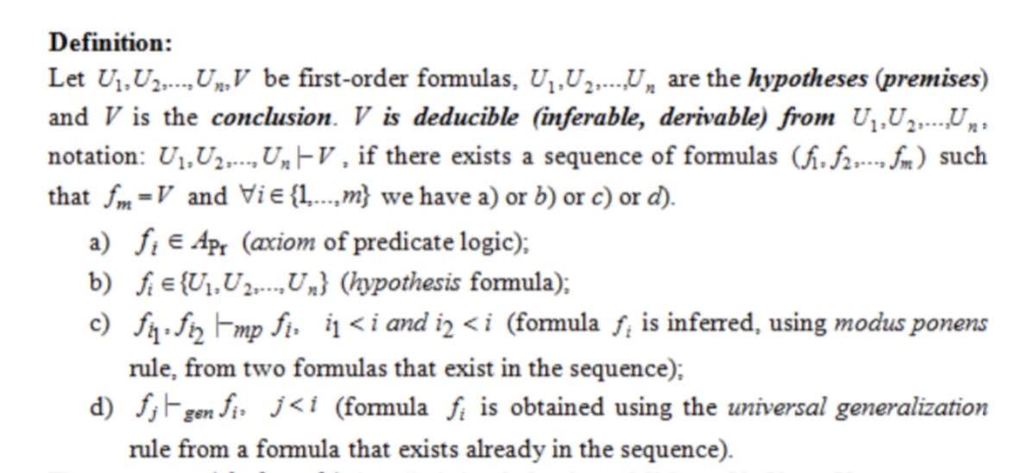

Slide 4
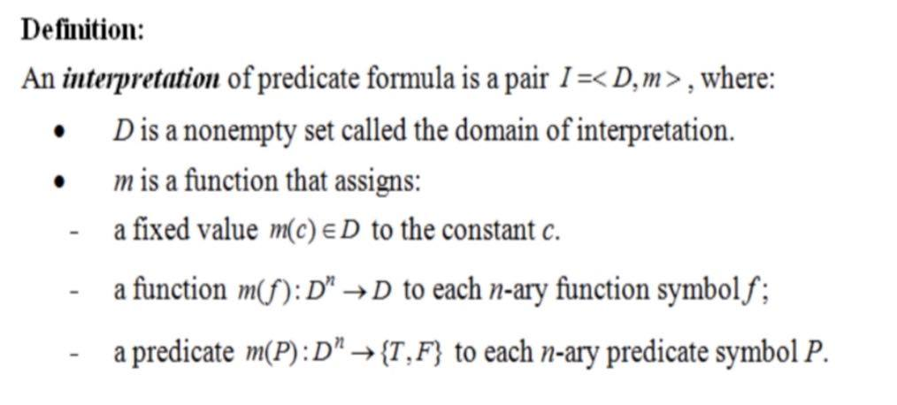

Slide 5
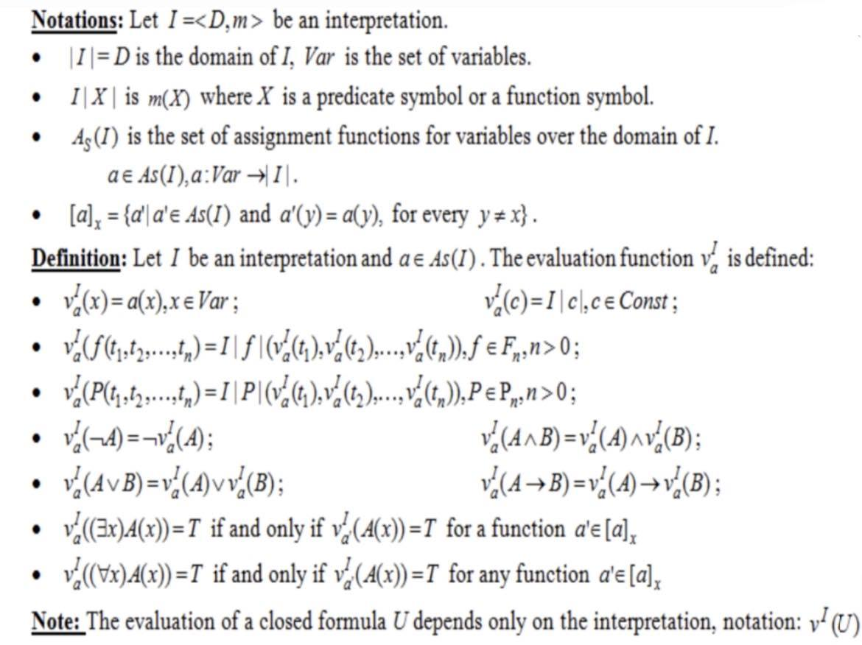

Slide 6
Solution
of problem statement 6.1

Slide 7
Choose an arbitrary interpretation with a finite domain (2 elements) for the formula:
U= (∀x)(A(x) ↔B(x)) → ((∀x)A(x) ↔ (∀x)B(x))
Let us consider the interpretation I=<D,m> , where :
D={6,18} – the domain of interpretation
m(A) : {6,18} → {T,F} , m(A)(x) = “x ⋮ 2”
m(B) :{6,18}→{T,F} , m(B)(x) = “x ⋮ 3”
To evaluate the formula U under the interpretation I, with the finite domain D={6,18} , the universally quantified subformulas are replaced by the conjunction of their instances for x=6 and x=18.

Slide 8
v (U) = v (∀x)(A(x) ↔B(x)) → v ((∀x)A(x) ↔ (∀x)B(x))
= v (∀x)(A(x) ↔B(x)) → v((∀x)A(x)) ↔ v((∀x)B(x))
=(18 ⋮ 2 ↔ 18 ⋮ 3) ∧ (6 ⋮ 2 ↔ 6 ⋮ 3) → (18 ⋮ 2 ∧ 6 ⋮ 2) ↔ (18 ⋮ 3 ∧ 6 ⋮ 3)
=(T ↔T) ∧ (T ↔T) → (T ↔T) ↔ (T ↔T)
Theory aspect: U ↔V implies (U →V) ∧ (V →U) and (U ∧ V) →(U ∨ V)
Therefore , (T ↔T) satisfies both of these conditions.
= T ∧ T → T ↔T
= T → T => True
v(U) is True under the interpretation of I , therefore I is a model of U.

